Slide 1


Unlocking the Future: Understanding Cryptocurrencies
Explore the transformative world of cryptocurrencies and their impact on our financial landscape.

Slide 2


Table of content
1
The Rise of Cryptocurrencies
2
What is Cryptocurrency?
3
Cryptocurrency vs. Traditional Currency
4
Common Use Cases of Cryptocurrencies
5
Why People Prefer Cryptocurrencies
6
Earning Money with Cryptocurrencies

Slide 3
Table of content
Getting Started with Cryptocurrency Investment
7
8
Short-Term Trading vs. Long-Term Holding
9
Staking for Passive Income
Could Cryptocurrencies Replace Traditional Banks?
Advantages of Cryptocurrency Transactions
Mining Cryptocurrencies: A Deep Dive
10
11
12

Slide 4
Table of content
13
Thank You!

Slide 5


The Rise of Cryptocurrencies
Cryptocurrencies have revolutionized financial landscapes globally, acting as digital currencies that operate on decentralized technology.
Unlike traditional currencies, cryptocurrencies aren't controlled by any central authority, promoting transparency and reducing fraud.
The surge in cryptocurrency adoption is driven by technological advancements and growing acceptance in mainstream finance.
Understanding this disruptive technology can empower individuals and businesses to thrive in a digital economy.

Slide 6

What is Cryptocurrency?
A cryptocurrency is a digital or virtual currency that uses cryptography for security, making it nearly impossible to counterfeit.
Unlike fiat money, cryptocurrencies operate on decentralized networks based on blockchain technology, ensuring trust and security.
Popular examples include Bitcoin and Ethereum, each serving different purposes within the financial ecosystem.
Their unique properties have sparked discussions about the future of money and finance.

Slide 7

Cryptocurrency vs. Traditional Currency
The key difference lies in decentralization; cryptocurrencies are not governed by any government, while traditional currencies are.
Transactions with cryptocurrencies are often quicker and cheaper, especially for international payments.
Fiat currencies are backed by governments, while cryptocurrencies rely on blockchain technology.
This difference opens up new avenues for financial freedom and innovation.

Slide 8

Common Use Cases of Cryptocurrencies
Cryptocurrencies are used for remittances, allowing for cheaper and faster international money transfers.
They're increasingly accepted in online shopping, providing a new payment option for consumers and businesses alike.
Investors use cryptocurrencies for trading and hedging against market volatility, diversifying their portfolios.
Moreover, cryptocurrencies are pivotal in decentralized finance (DeFi), providing services typically offered by banks.

Slide 9
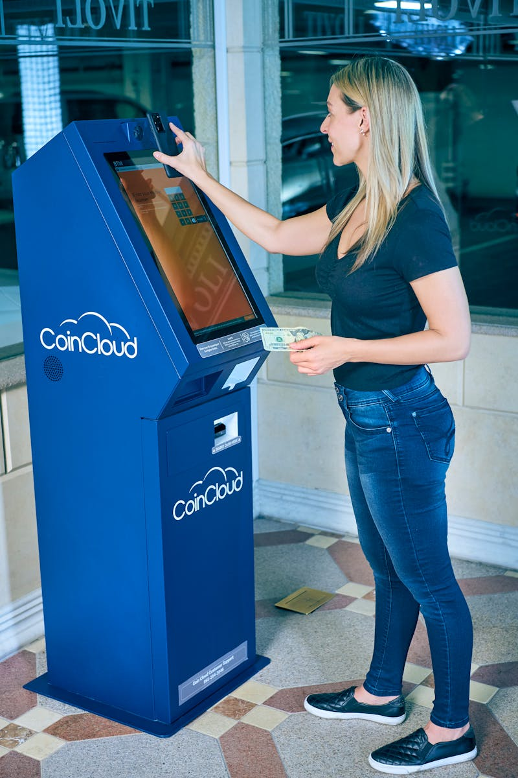
Why People Prefer Cryptocurrencies
Many users see cryptocurrencies as a hedge against inflation and economic instability, especially in volatile regions.
Cryptocurrencies provide anonymity and security, appealing to those concerned about privacy.
The potential for high returns attracts investors seeking alternative assets in their investment portfolios.
Global accessibility enables individuals from all walks of life to participate in the financial ecosystem.

Slide 10

Earning Money with Cryptocurrencies
Investors can profit through trading, buying low and selling high, leveraging market fluctuations for gains.
Staking allows individuals to earn rewards for holding specific cryptocurrencies, generating passive income.
Participating in Initial Coin Offerings (ICOs) offers opportunities to invest early in emerging projects.
Mining cryptocurrencies involves validating transactions and earning rewards, albeit requiring significant technical know-how.

Slide 11

Getting Started with Cryptocurrency Investment
Research and education are crucial before diving into cryptocurrency investments; understanding the market is essential.
Choosing a reputable exchange is vital for buying and selling cryptocurrencies safely and efficiently.
Diversifying your investment across multiple cryptocurrencies can mitigate risks and enhance profit potential.
Starting with a small investment allows for gradual understanding and experience in the volatile market.

Slide 12

Short-Term Trading vs. Long-Term Holding
Short-term trading involves capitalizing on market volatility, requiring constant monitoring and strategy adjustment.
Long-term holding, or HODLing, is about patience and belief in the future value of cryptocurrencies.
Both strategies have their pros and cons; understanding personal risk tolerance is key to choosing a path.
Investors often mix both strategies for a balanced approach to portfolio management.

Slide 13

Staking for Passive Income
Staking involves locking up a cryptocurrency to support the network's operations, earning rewards in return.
Many coins like Cardano and Tezos offer staking options, appealing to investors for passive income generation.
It's different from traditional investment methods, requiring minimal effort once set up, often through a wallet.
Staking can lead to significant returns, especially in a growing market.

Slide 14

Could Cryptocurrencies Replace Traditional Banks?
While cryptocurrencies offer alternatives to traditional banking, they also pose challenges and regulatory concerns.
Banks excel in services like loans and savings, while cryptocurrencies predominantly focus on transactions and investments.
The future may see hybrid models where traditional banks integrate blockchain technology for efficiency.
However, trust and regulatory compliance remain major hurdles for full replacement.

Slide 15

Advantages of Cryptocurrency Transactions
Cryptocurrency transactions are generally quicker and cheaper than traditional banking methods, enhancing user experience.
Decentralization minimizes fraud risks, making transactions safer and more transparent.
Cryptocurrencies offer users full control over their funds without reliance on financial institutions.
Global accessibility facilitates international transactions without excessive fees.

Slide 16

Mining Cryptocurrencies: A Deep Dive
Mining is the process of validating transactions on the blockchain, requiring significant computing power and energy.
Bitcoin mining, for instance, involves a competitive process where miners solve complex mathematical problems.
This process secures the network, but also raises questions about environmental impact and sustainability.
Understanding mining helps demystify a crucial aspect of how cryptocurrencies function and maintain security.

Slide 17

Thank You!
Thank you for exploring the fascinating world of cryptocurrencies with us today!
We hope you now understand the pivotal role cryptocurrencies play in today's economy.
Your journey into crypto investment begins with knowledge and a willingness to learn.
Feel free to reach out with any questions or discussions regarding this topic!

